Slide 1
PLC Programming Part 2
Using a Control Structure to write a PLC sequence

Slide 2
PLC Programming
In Part 1, we discuss a basic control structure and programming paradigm, Structure programming, to aid in software development.
In Part 2, we are going to discuss how to use the control structure to write your programs

Slide 3
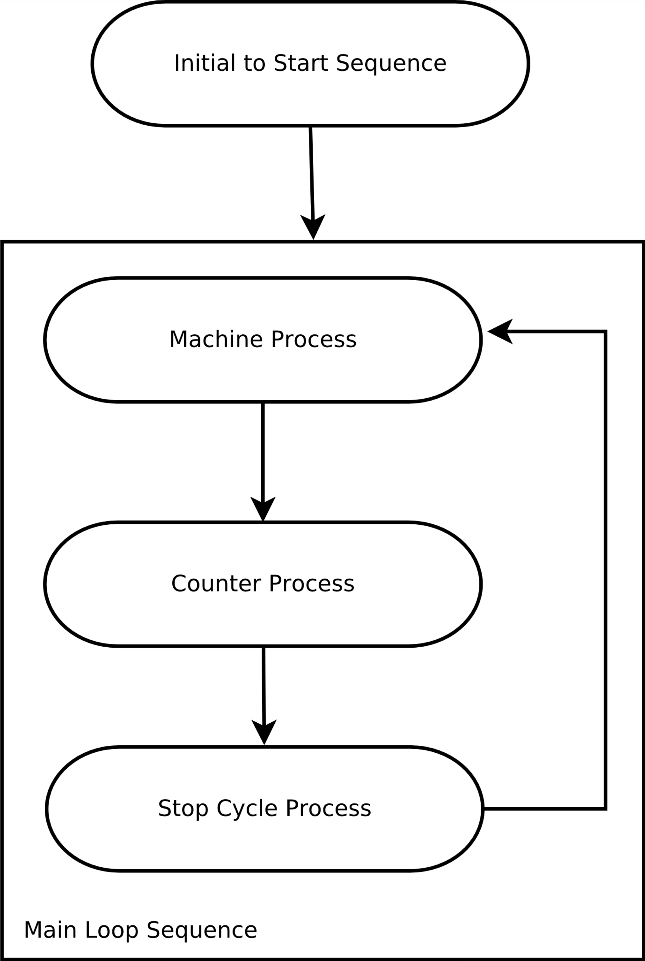
PLC Programming
Machine programs consist of
Initialization Sequence
Serve to prep the system for the main sequence
Runs once at the start of the machine process
Main Loop Sequence
Serve as the Top-Level Loop Sequence
Contains
Machine Process
Counter Process
Stop Cycle Process

Slide 4
PLC Programming
Main Loop Sequence

Slide 5
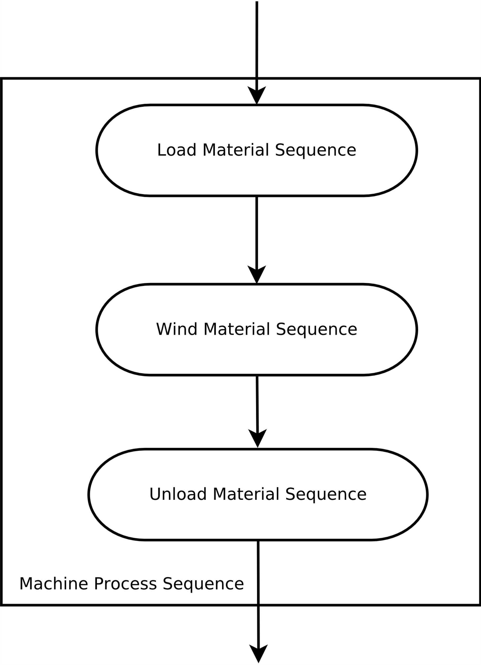
PLC Programming
Machine Process
Used flowchart to define the process and module so that a team of programmer can work on the same project at same time.
Define the overall process Ex. (Battery Winder)
Load Material Sequence
Wind Material Sequence
Unload Material Sequence
Further brake down the process
Load Material Sequence
Stage

Slide 6
PLC Programming
Counter Process
Used to process to all the counter info that has been incremented in the last machine cycle
Determine whether to stop or display a message.

Slide 7
PLC Programming
Machine Process
Further brake down the process (Ex Load Material Sequence)
Stage

Slide 8
PLC Programming
Stop Cycle Process

